Slide 1
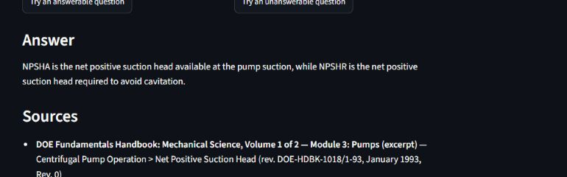
MANUFACTURING RAG ASSISTANT
A RAG demo that
shows its work
Controlled manufacturing corpus. Every answer must earn its sources—or refuse.
14 docs · 228 chunks · EN / ES · live
FUNCTIONAL DEMO · NOT PRODUCTION
PUBLIC PORTFOLIO DEMO · EVIDENCE UPDATED SEP 7, 2026
Notes:
[Sources]
- https://jehulara-manufacturing-rag-assistant-live.hf.space/
- Live browser check performed 2026-08-29; screenshot captured from a concise cited answer.
[/Sources]

Slide 2
HOW IT WORKS
2 / 5
Retrieval and generation stay inspectable
01
02
03
04
05
Controlled corpus
Hybrid retrieval
Refusal gate
External LLM
Answer + sources
9 public + 5 clearly labeled synthetic documents
BM25 + BAAI/bge-m3
Threshold blocks weak evidence
Generates only after retrieval passes
Uncited output becomes a refusal
Public nginx exposes the UI plus /health and /ready. The internal query route and API documentation return 404 externally.
PUBLIC PORTFOLIO DEMO · EVIDENCE UPDATED SEP 7, 2026
Notes:
[Sources]
- https://github.com/Jehu-Lara/manufacturing-rag-assistant/blob/d2a74aaab14ace82c8e202351cad30fb5a89d79c/README.md
- https://github.com/Jehu-Lara/manufacturing-rag-assistant/blob/d2a74aaab14ace82c8e202351cad30fb5a89d79c/nginx.conf
- Live HTTP route check performed 2026-08-29.
[/Sources]

Slide 3
EVALUATION
3 / 5
Evaluate retrieval and generation separately
Recall@5
Correct refusal
Faithfulness
Citation accuracy
0.887
0.900
0.967
0.767
CURRENT PROFILE
HISTORICAL
HIST. · 29 / 30
HIST. · BELOW TARGET
Current retrieval: Recall@5 0.887 (ES 0.844, n=32; EN 0.917, n=48). Generation cards preserve historical raw-v1 / eval_set v1.0.0 measurements.
PUBLIC PORTFOLIO DEMO · EVIDENCE UPDATED SEP 7, 2026
Notes:
[Sources]
- https://aclanthology.org/2024.eacl-demo.16/
- https://cloud.google.com/blog/products/ai-machine-learning/optimizing-rag-retrieval
- https://github.com/Jehu-Lara/manufacturing-rag-assistant/tree/d2a74aaab14ace82c8e202351cad30fb5a89d79c/reports
[/Sources]

Slide 4
OBSERVED LIVE
4 / 5
One concise answer keeps its source in view
DIRECT CHECK
The answer is one sentence. The governing source stays readable beside it.
Question: What is the difference between NPSHA and NPSHR?
Captured Aug 29, 2026
PUBLIC PORTFOLIO DEMO · EVIDENCE UPDATED SEP 7, 2026
Notes:
[Sources]
- https://jehulara-manufacturing-rag-assistant-live.hf.space/
- Authentic screenshot captured during a live browser check on 2026-08-29.
[/Sources]

Slide 5
PORTFOLIO BOUNDARY
5 / 5
The demo is credible because its limits stay visible
SUPPORTED
NOT ESTABLISHED
✓ Public bilingual web demo
— Production readiness or SLA
✓ Controlled manufacturing corpus
— Real factory or client deployment
✓ Hybrid semantic + lexical retrieval
— Industrial performance or scale
✓ Source citations and refusal behavior
— Business savings or ROI
✓ Containerized, SHA-gated deployment
— Error elimination or causal impact
✓ Protected internal API surface
— Coverage beyond the controlled corpus
Position it as a functional public demo — never as a production system.
PUBLIC PORTFOLIO DEMO · EVIDENCE UPDATED SEP 7, 2026
Notes:
[Sources]
- https://github.com/Jehu-Lara/manufacturing-rag-assistant/tree/d2a74aaab14ace82c8e202351cad30fb5a89d79c
- https://github.com/Jehu-Lara/manufacturing-rag-assistant/actions/runs/33279877573
- Scope boundaries supplied and approved by the project owner for portfolio publication.
[/Sources]

Slide 6
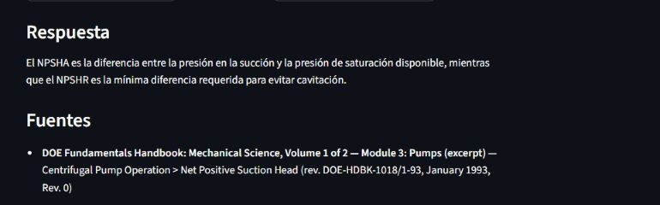
ASISTENTE RAG DE MANUFACTURA
Una demo RAG que
muestra su evidencia
Corpus controlado de manufactura. Cada respuesta debe justificar sus fuentes o rechazar.
14 docs · 228 fragmentos · EN / ES · en vivo
DEMO FUNCIONAL · NO PRODUCCIÓN
DEMO PÚBLICA DE PORTAFOLIO · EVIDENCIA ACTUALIZADA 7 SEP 2026
Notes:
[Sources]
- https://jehulara-manufacturing-rag-assistant-live.hf.space/
- Live browser check performed 2026-08-29; screenshot captured from a concise cited answer.
[/Sources]

Slide 7
CÓMO FUNCIONA
2 / 5
La recuperación y la generación permanecen inspeccionables
01
02
03
04
05
Corpus controlado
Recuperación híbrida
Gate de rechazo
LLM externo
Respuesta + fuentes
9 públicos + 5 sintéticos etiquetados
BM25 + BAAI/bge-m3
El umbral bloquea evidencia débil
Genera solo después de superar la recuperación
Una salida sin citas se convierte en rechazo
El nginx público expone la interfaz junto con /health y /ready. La ruta interna de consulta y la documentación API devuelven 404 externamente.
DEMO PÚBLICA DE PORTAFOLIO · EVIDENCIA ACTUALIZADA 7 SEP 2026
Notes:
[Sources]
- https://github.com/Jehu-Lara/manufacturing-rag-assistant/blob/d2a74aaab14ace82c8e202351cad30fb5a89d79c/README.md
- https://github.com/Jehu-Lara/manufacturing-rag-assistant/blob/d2a74aaab14ace82c8e202351cad30fb5a89d79c/nginx.conf
- Live HTTP route check performed 2026-08-29.
[/Sources]

Slide 8
EVALUACIÓN
3 / 5
Evalúa recuperación y generación por separado
Recall@5
Rechazo correcto
Fidelidad
Precisión de citas
0.887
0.900
0.967
0.767
PERFIL ACTUAL
HISTÓRICO
HIST. · 29 / 30
HIST. · BAJO META
Recuperación actual: Recall@5 0.887 (ES 0.844, n=32; EN 0.917, n=48). Las tarjetas de generación conservan mediciones históricas de raw-v1 / eval_set v1.0.0.
DEMO PÚBLICA DE PORTAFOLIO · EVIDENCIA ACTUALIZADA 7 SEP 2026
Notes:
[Sources]
- https://aclanthology.org/2024.eacl-demo.16/
- https://cloud.google.com/blog/products/ai-machine-learning/optimizing-rag-retrieval
- https://github.com/Jehu-Lara/manufacturing-rag-assistant/tree/d2a74aaab14ace82c8e202351cad30fb5a89d79c/reports
[/Sources]

Slide 9
OBSERVADO EN VIVO
4 / 5
Respuesta breve. Fuente visible.
COMPROBACIÓN DIRECTA
La respuesta ocupa una frase. La fuente técnica permanece legible junto a ella.
Pregunta: ¿Cuál es la diferencia entre NPSHA y NPSHR?
Capturado 29 ago 2026
DEMO PÚBLICA DE PORTAFOLIO · EVIDENCIA ACTUALIZADA 7 SEP 2026
Notes:
[Sources]
- https://jehulara-manufacturing-rag-assistant-live.hf.space/
- Authentic screenshot captured during a live browser check on 2026-08-29.
[/Sources]

Slide 10
LÍMITE DE PORTAFOLIO
5 / 5
La demo es creíble porque mantiene visibles sus límites
RESPALDADO
NO ESTABLECIDO
✓ Demo web pública y bilingüe
— Preparación para producción o SLA
✓ Corpus controlado de manufactura
— Despliegue real en fábrica o cliente
✓ Recuperación semántica + léxica
— Desempeño o escala industrial
✓ Citas de fuentes y comportamiento de rechazo
— Ahorros empresariales o ROI
✓ Despliegue en contenedor controlado por SHA
— Eliminación de errores o impacto causal
✓ Superficie API interna protegida
— Cobertura fuera del corpus controlado
Preséntalo como demo pública funcional — nunca como sistema en producción.
DEMO PÚBLICA DE PORTAFOLIO · EVIDENCIA ACTUALIZADA 7 SEP 2026
Notes:
[Sources]
- https://github.com/Jehu-Lara/manufacturing-rag-assistant/tree/d2a74aaab14ace82c8e202351cad30fb5a89d79c
- https://github.com/Jehu-Lara/manufacturing-rag-assistant/actions/runs/33279877573
- Scope boundaries supplied and approved by the project owner for portfolio publication.
[/Sources]

